Slide 1
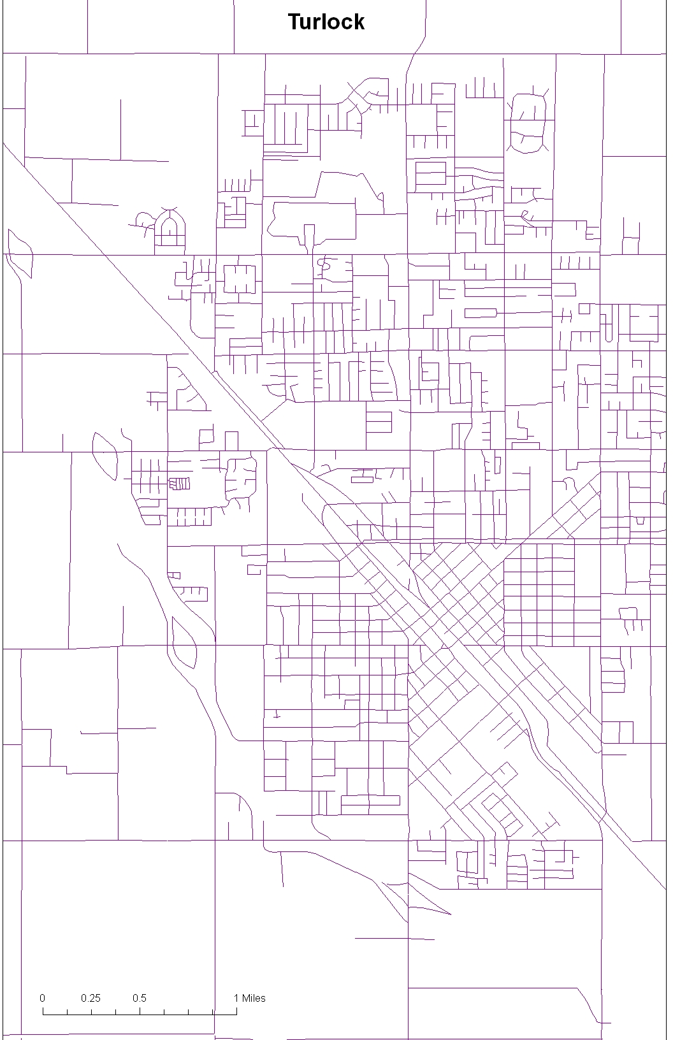
Each colored block
Is roughly 0.5 x 0.5 mile square
Great precision is not required in this calculation
Turlock 1

Slide 2
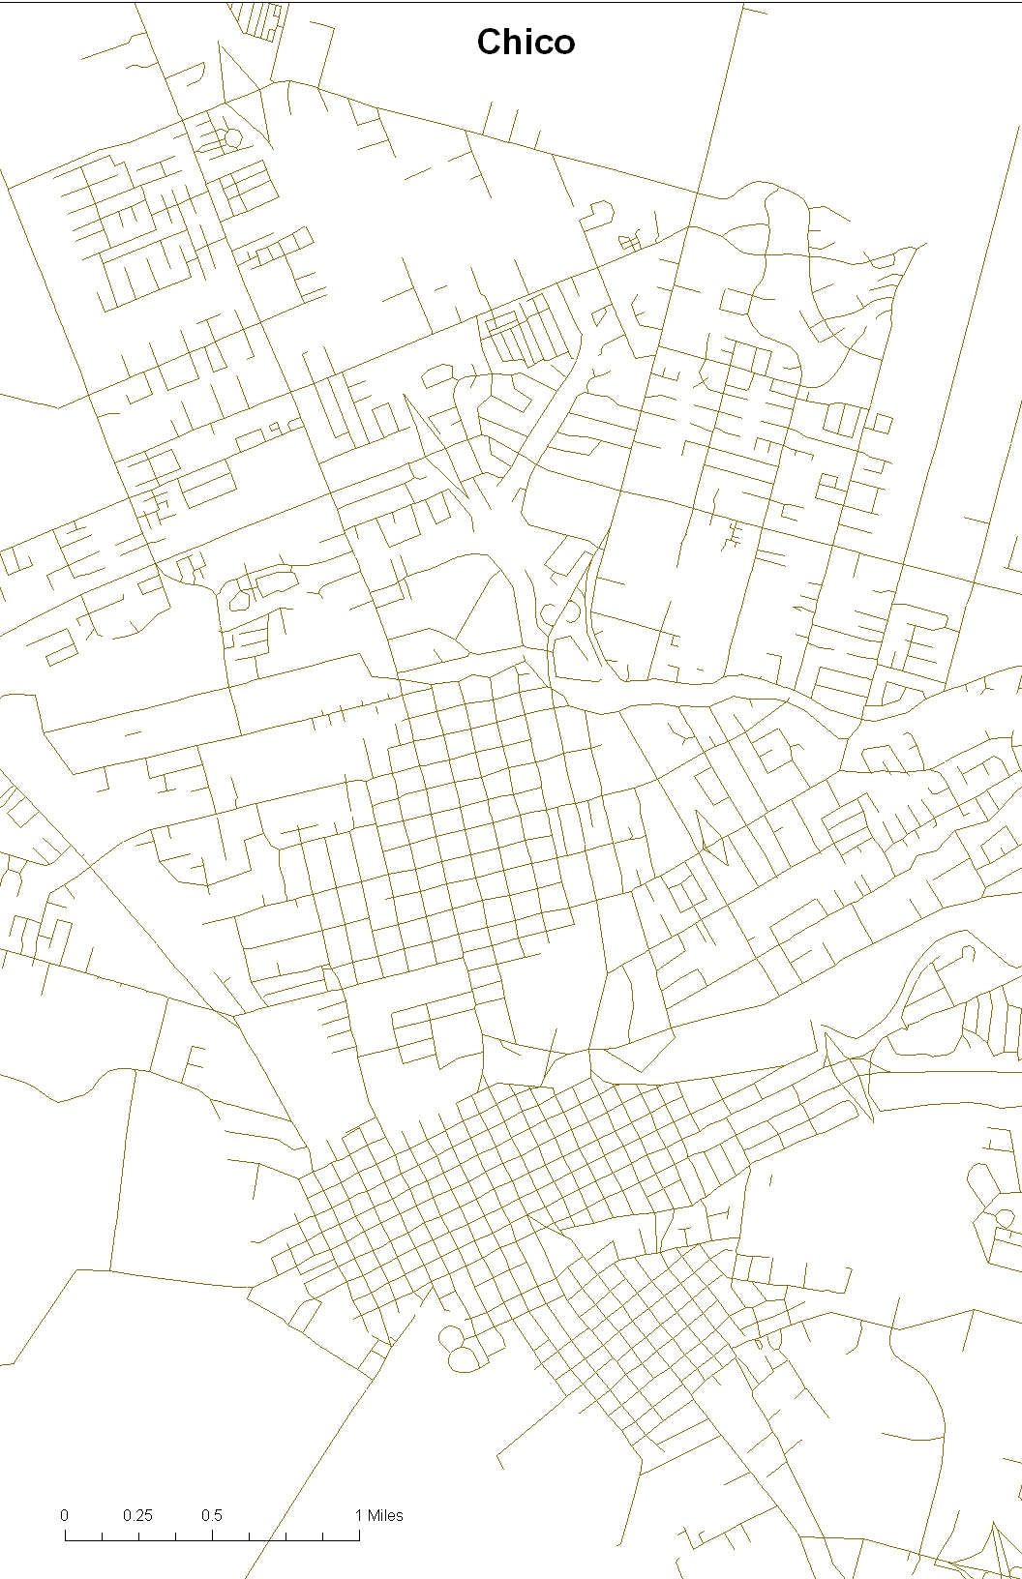
Chico 3
Chico 2
Chico 1

Slide 3
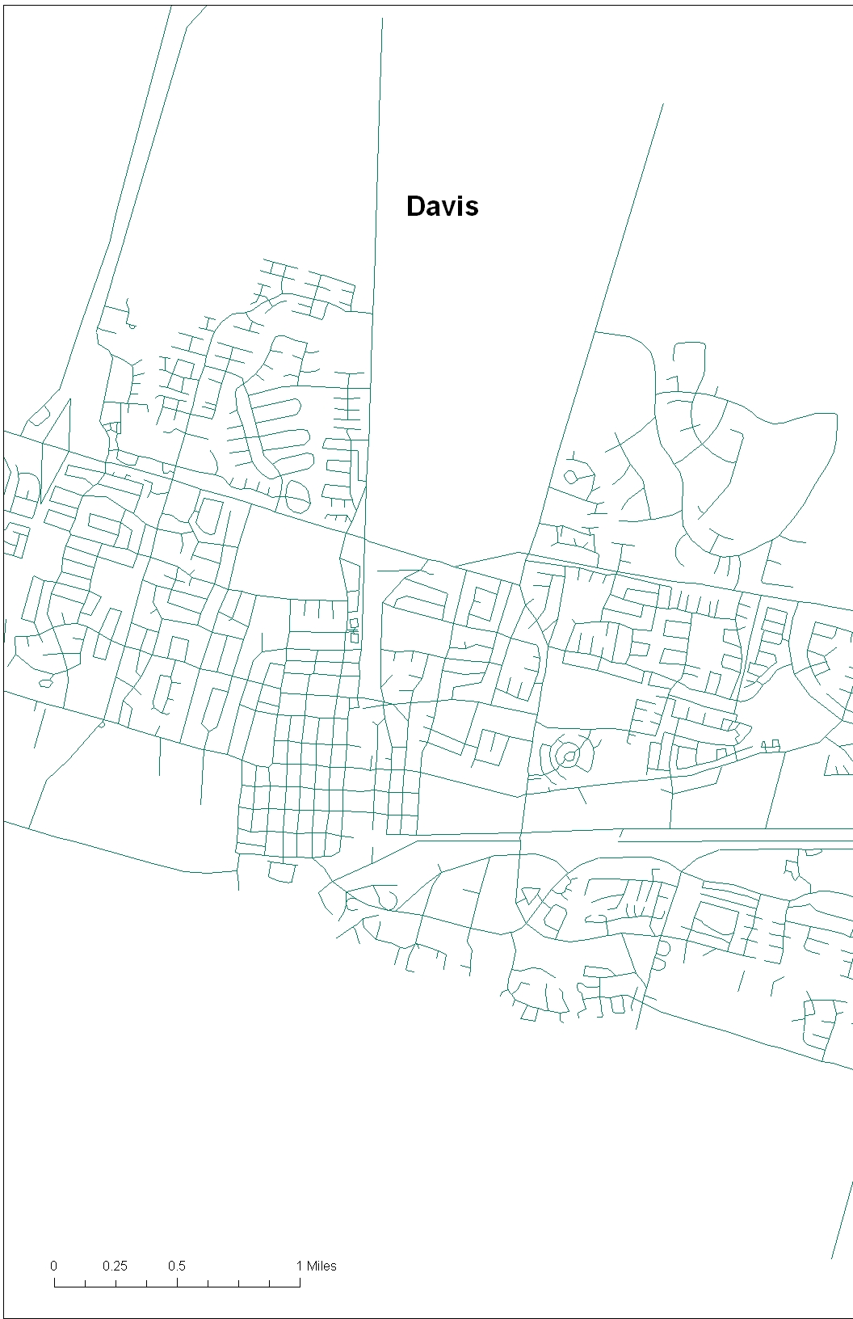
Davis 1

