Slide 1
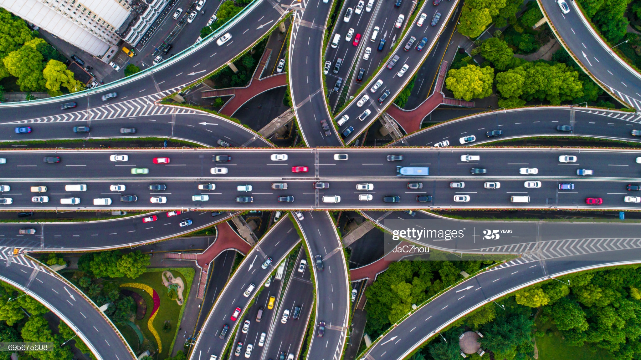
Homework 8 Question 1
N

Slide 2
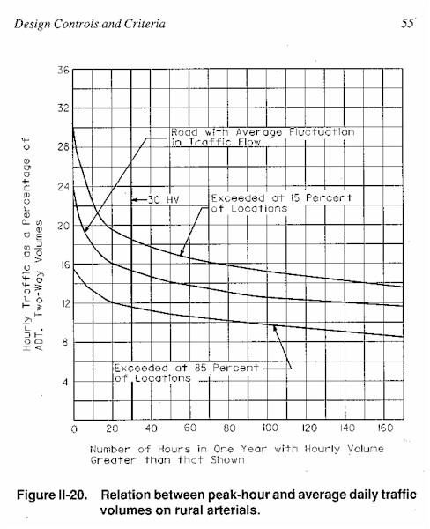
ADT and Design Hour Volume – Rural Roads from AASHTO
Norman W. Garrick
Notes:
2

